Slide 1
Design and Analysis of Algorithms
Overview of Modules 1-3

Slide 2
Introductory concepts
What is an algorithm?
It’s a sequence of steps that transforms the input into the output i.e. a sequence of steps that attempt to solve a problem
A problem is stated as a relationship between input conditions and output expectations

Slide 3
How to state/represent an algorithm: Pseudocode
Pseudocode is an artificial and informal language that helps programmers develop algorithms. Pseudocode is very similar to everyday English.

Slide 4
Pseudocode & Algorithm
Example 1: Write an algorithm to determine a student’s final grade and indicate whether it is passing or failing. The final grade is calculated as the average of four marks.

Slide 5
Pseudocode & Algorithm
Pseudocode:
Input a set of 4 marks
Calculate their average by summing and dividing by 4
if average is below 50
Print “FAIL”
else
Print “PASS”

Slide 6
Pseudocode & Algorithm
Detailed Algorithm
Step 1: Input M1,M2,M3,M4
Step 2: GRADE ← (M1+M2+M3+M4)/4
Step 3: if (GRADE < 50) then
Print “FAIL”
else
Print “PASS”
endif

Slide 7
Algorithm cont’d - Flowcharts
How do you represent/state an algorithm?
A graphical representation of the sequence of operations in an information system or program.
Information system flowcharts show how data flows from source documents through the computer to final distribution to users.
Program flowcharts show the sequence of instructions in a single program or subroutine. Different symbols are used to draw each type of flowchart.

Slide 8
The Flowchart
A Flowchart
shows logic of an algorithm
emphasizes individual steps and their interconnections
e.g. control flow from one action to the next

Slide 9
Flowchart Symbols
Basic

Slide 10
Example 1
START
Step 1: Input M1,M2,M3,M4
Step 2: GRADE ← (M1+M2+M3+M4)/4
Step 3: if (GRADE <50) then
Print “FAIL”
else
Print “PASS”
endif
Input
M1,M2,M3,M4
GRADE←(M1+M2+M3+M4)/4
IS
GRADE<50
N
Y
PRINT
“PASS”
PRINT
“FAIL”
STOP

Slide 11
Example 2
Write an algorithm and draw a flowchart to convert the length in feet to centimeter.
Pseudocode:
Input the length in feet (Lft)
Calculate the length in cm (Lcm) by multiplying LFT with 30
Print length in cm (LCM)

Slide 12
Example 2
Flowchart
Algorithm
Step 1: Input Lft
Step 2: Lcm ← Lft x 30
Step 3: Print Lcm
START
Input
Lft
Lcm ← Lft x 30
Print
Lcm
STOP

Slide 13
Example 3
Write an algorithm and draw a flowchart that will read the two sides of a rectangle and calculate its area.
Pseudocode
Input the width (W) and Length (L) of a rectangle
Calculate the area (A) by multiplying L with W
Print A

Slide 14
Example 3
Algorithm
Step 1: Input W,L
Step 2: A ← L x W
Step 3: Print A
START
Input
W, L
A ← L x W
Print
A
STOP

Slide 15
Flowcharts
Flowcharts is a graph used to depict or show a step by step solution using symbols which represent a task.
The symbols used consist of geometrical shapes that are connected by flow lines.
It is an alternative to pseudocoding; whereas a pseudocode description is verbal, a flowchart is graphical in nature.

Slide 16
Flowchart Symbols
Terminal symbol - indicates the beginning and
end points of an algorithm.
Process symbol - shows an instruction other than
input, output or selection.
Input-output symbol - shows an input or an output
operation.
Disk storage I/O symbol - indicates input from or output to disk storage.
Printer output symbol - shows hardcopy printer
output.

Slide 17
Flowchart Symbols cont…
Selection symbol - shows a selection process
for two-way selection.
Off-page connector - provides continuation of a logical path on another page.
On-page connector - provides continuation
of logical path at another point in the same
page.
Flow lines - indicate the logical sequence of
execution steps in the algorithm.

Slide 18
Flowchart – sequence control structure
Flowcharts of main control structures
Statement 1
Statement 2
Statement 3
:

Slide 19
Flowchart – selection control structure
No
Yes
Condition
else-
statement(s)
then-
statement(s)

Slide 20
Flowchart – repetition/loop control structure
yes
Loop
Statement(s)
Condition
no

Slide 21
Flowchart – example
Begin
Read age
YES
Age > 60?
NO
print “Retired”
print “Not retired”
End

Slide 22
Flowchart – example
Begin
sum = 0
current_number = 1
NO
current_number <= 10?
print sum
YES
sum = sum + current_number
current_number = current_number + 1
End

Slide 23
Exercise 1 – for your practice
Write an algorithm and draw a flowchart that will calculate the roots of a quadratic equation
Hint: d = sqrt ( ), and the roots are: x1 = (–b + d)/2a and x2 = (–b – d)/2a

Slide 24
CHARACTERISTICS OF ALGORITHM
Donald Ervin Knuth has given a list of five Xtics for an algorithm, these are:
FINITENESS
DEFINITENESS
INPUT
OUTPUT
EFFECTIVENESS

Slide 25
But what makes a good algorithm?
Algorithms are generally measured by 2 standards:
Correctness – an algorithm is always correct
use a formal proof of correctness
Efficiency – How much resources does it use (mostly we are concerned with time and space)
We use quantitative resource analysis (formal runtime analysis)

Slide 26

What is a design of an algorithm?
In design one is defining a systematic solution to a problem
A step-by-step procedure that can be followed to solve a problem
What are the main concerns?
What data structures should we use? (More in module 8)
What strategy/ approach can help solve the problem? Brute force, greedy, divide and conquer or dynamic programming
- we should have an idea of what they are, but more in modules 5-7

Slide 27
What data structure should we use?
Choosing the Right Data Structure: (more in Module 8)
Queues, Stacks, Binary Search Trees, Red-Black Trees, and AVL Trees
Discuss which structure is better suited for specific problems like:
Searching
Insertion
Deletion
Balancing

Slide 28
Design Strategies - Brute Force Algorithms:
Approach: Examines every possible solution to a problem.
Implementation: Typically straightforward to implement, but computationally expensive.
Time Complexity: Often proportional to the size of the search space, which can grow exponentially with the input.
Guaranteed Solution: If a solution exists, a brute force algorithm will eventually find it.
Example: Finding the maximum element in an array by comparing all elements.

Slide 29
Design Strategies - Greedy Algorithms:
Approach:
Makes locally optimal choices at each step, hoping to find a globally optimal solution.
Implementation:
Can be faster than brute force algorithms, especially for certain problems.
Time Complexity:
Varies depending on the problem, but often has a lower time complexity than brute force.
Guaranteed Solution:
Not always guaranteed to find the optimal solution for all problems.
Example:
Making change with the fewest coins by always choosing the largest denomination possible.

Slide 30
Design Strategies - Divide and Conquer
Key Steps:
1. Divide:
The algorithm first divides the original problem into smaller, non-overlapping subproblems.
2. Conquer:
Each subproblem is then solved recursively, or if small enough, solved directly.
3. Combine:
Finally, the solutions to the subproblems are combined to produce the solution to the original problem.

Slide 31
Divide and conquer - example
Consider sorting a list of numbers. A divide and conquer approach, like merge sort, would:
Divide: Split the list into two smaller sublists.
Conquer: Recursively sort each sublist.
Combine: Merge the two sorted sublists into a single sorted list.

Slide 32
Design Strategies - Dynamic Programming
How Dynamic Programming Works:
1. Define Subproblems:
Identify the smaller, overlapping subproblems that make up the larger problem.
2. Build a Table or Cache:
Create a data structure (like a table, dictionary, or array) to store the solutions to these subproblems.
3. Solve Subproblems:
Compute the solutions to the subproblems, typically starting with the smallest and working towards the larger ones.
4. Retrieve Solutions:
When a larger subproblem (or the overall problem) needs a solution, look up the solution in the table or cache instead of recalculating it.
5. Combine Solutions:
Combine the solutions to the subproblems to find the optimal solution to the original problem.

Slide 33
Examples of Problems Solved with Dynamic Programming: (covered in Module 5 & 6)
Fibonacci Sequence: Calculating the nth Fibonacci number efficiently.
Knapsack Problem: Determining the most valuable subset of items that can be placed in a knapsack with a limited weight capacity.
Shortest Path Problems: Finding the shortest path between two points in a graph (e.g., Bellman-Ford algorithm).
Longest Increasing Subsequence: Finding the longest increasing subsequence within a given sequence.
Edit Distance: Calculating the minimum number of edits (insertions, deletions, substitutions) required to transform one string into another

Slide 34
What is Analysis of algorithm?
Evaluating the performance and efficiency of an algorithm
How does the algorithm scale with input size in terms of time and space?
So for analysis the focus is on complexity!
Time complexity – How running time of an algorithm changes with the size of the input
Space complexity – How the amount of memory an algorithm uses changes with the size of the input

Slide 35
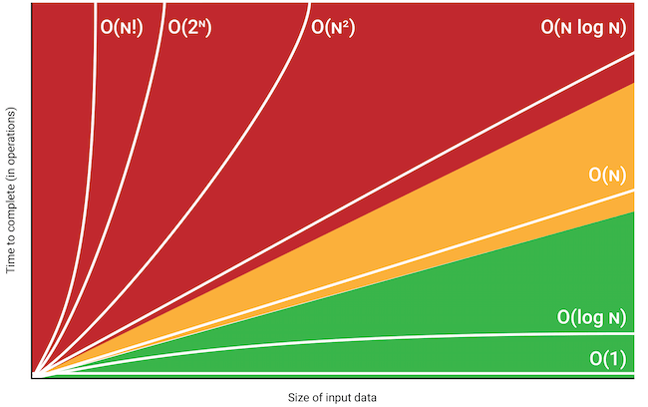
Common complexities – Big O notation used

Slide 36
How do we determine the complexity of an algorithm?
Priori Vs Posteriori?
We use cpu computations and main memory space required
CPU computations are instructions executed by the cpu (runtime functions)
Runtime functions are non-negative and non-decreasing

Slide 37

What if the runtime function is given?
Assume you are given the runtime function as;
$$T\left(n\right)=2n^{2}+3n+1$$
What is its time complexity?
Drop lower order terms
Drop the constant multiplier
Thus O(n^2)

Slide 38
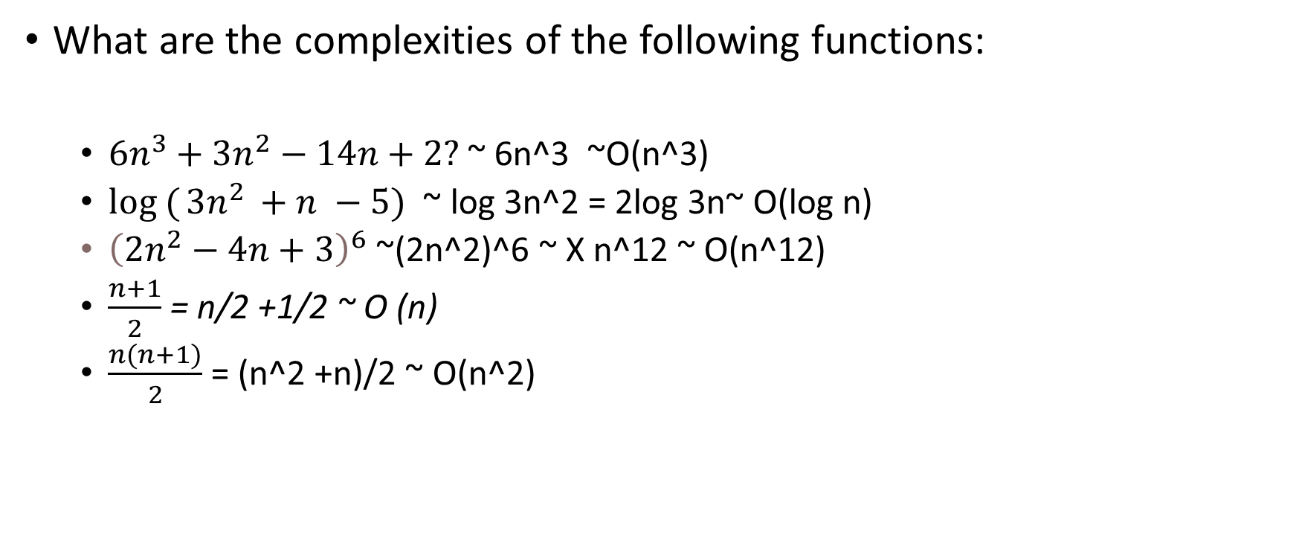
Other examples
What are the complexities of the following functions:
$6n^{3}+3n^{2}−14n+2?$ ~ 6n^3 ~O(n^3)
$log ({3n^{2 }+n −5)}$ ~ log 3n^2 = 2log 3n~ O(log n)
${\left(2n^{2}−4n+3\right)}^{6}$ ~(2n^2)^6 ~ X n^12 ~ O(n^12)
$\frac{n+1}{2}$ = n/2 +1/2 ~ O (n)
$\frac{n(n+1)}{2}$ = (n^2 +n)/2 ~ O(n^2)

Slide 39
What if the function is not given?
Estimation is done using total cpu computations!
function isPrime(n)
{ for (let i = 2; i < n; ++i) //1+n-2+n-2+n-2 ~ 3n-5 = O(n)
{ if (n % i === 0) { return false; } } return true; }
function isPrime(n)
{ for (let i = 2; i <= Math.sqrt(n); ++i)
{ if (n % i === 0) { return false; } } return true; }

Slide 40
What if the function is not given?
def find_max(arr):
max_value = arr[0] //1time
for i in range(1, len(arr)): // //n+1
if arr[i] > max_value: //n times
max_value = arr[i] //less than n
return max_value
1+n+1+n +n + 1= 3n+3 = O(n)
for (let i = 0; i < n; ++i)
{ statement; }
1+n+1+n +n = 3n+2 = O(n)

Slide 41
What if the function is not given?
def print_all_pairs(arr):
for i in range(len(arr)): //n times
for j in range(len(arr)): //n times print(arr[i], arr[j])
O(n^2)

Slide 42
Exercises…what is the complexity?
While ( i < n) for (i=0; i<n;i++)
{ statements; { statements;
i++ }
}
For (i=1; i<n; i=i*2)
{
statements;
}

Slide 43
What is the complexity for
Insertion sort algorithm?
Bubble sort algorithm?
An algorithm that has a recursive fn?
Quicksort algorithm?
Binary search algorithm?.....guess
Merge sort algorithm?.....guess

Slide 44
Insertion sort
See slides on Insertion sort for;
How does it work?
Illustrative example
Time / space Complexity?

Slide 45
Bubble sort
See slides on bubble sort for;
How does it work?
Illustrative example
Time / space Complexity?

Slide 46
Quick sort
See slides on Quick sort for;
How does it work?
Illustrative example
Time / space Complexity?

Slide 47
Binary search
See slides on binary search for;
How does it work?
Illustrative example
Time / space Complexity?

Slide 48
Merge Sort
See slides on merge sort for;
How does it work?
Illustrative example
Time / space Complexity?

Slide 49
Asymptotic Notation
•When we look at a large enough input n, we’re studying the asymptotic efficiency
• Concerned with the running time as the input increases without bound
• Usually, an algorithm that is asymptotically more efficient is the best choice (except for small n)
Asymptotic notation is a shorthand used to give a quick measure of the behavior of a function f (n) as n grows large. It is normally used to refer to a set of functions

Slide 50
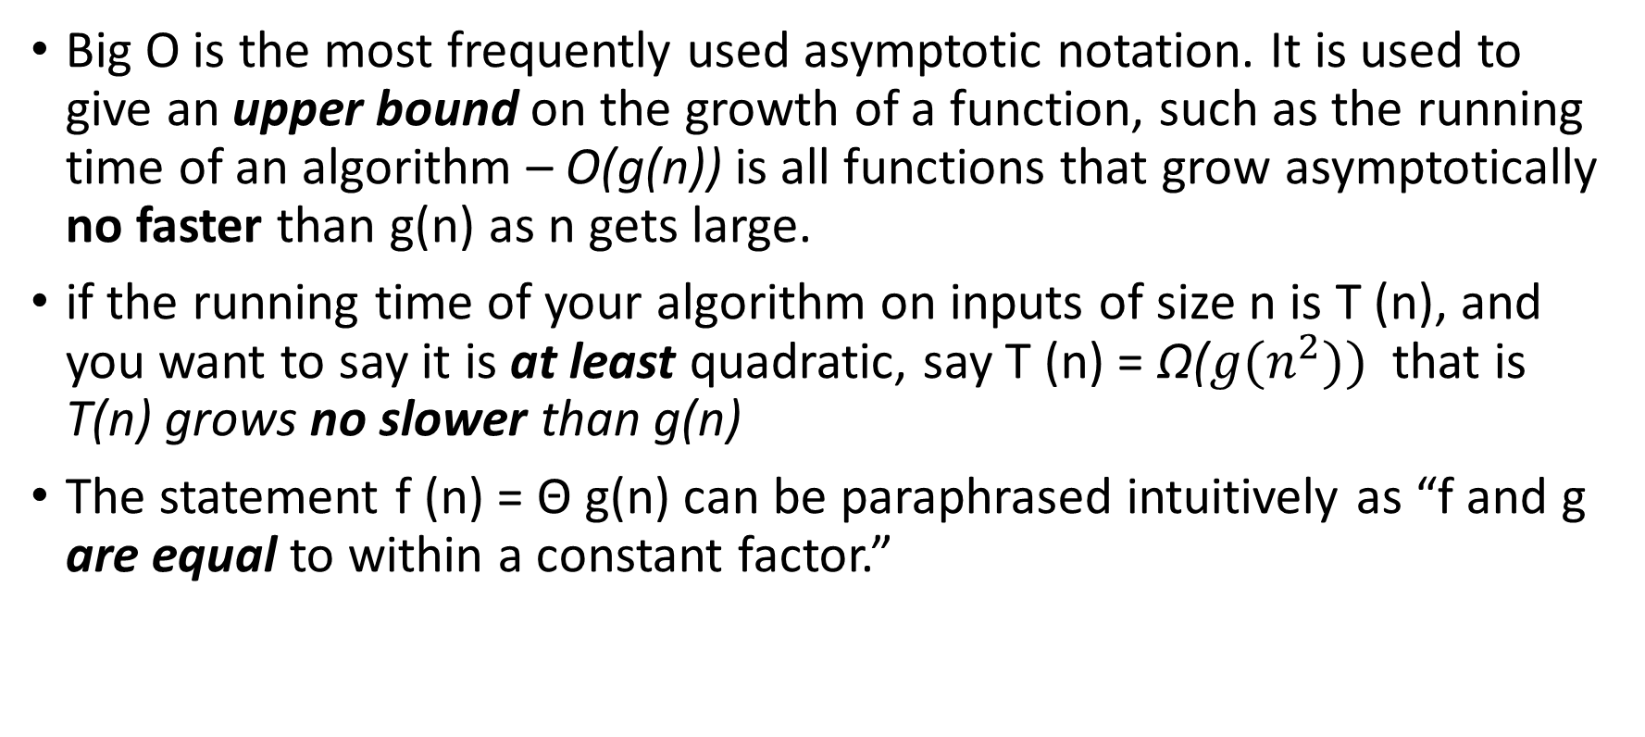
Asymptotic notation
Big O is the most frequently used asymptotic notation. It is used to give an upper bound on the growth of a function, such as the running time of an algorithm – O(g(n)) is all functions that grow asymptotically no faster than g(n) as n gets large.
if the running time of your algorithm on inputs of size n is T (n), and you want to say it is at least quadratic, say T (n) = Ω(${g(n}^{2}))$ that is T(n) grows no slower than g(n)
The statement f (n) = Θ g(n) can be paraphrased intuitively as “f and g are equal to within a constant factor.”

Slide 51
Formally – Big Oh (O(n)) – “upper bound”
For a given function g(n), we denote by O(g(n)) the set of functions. O(g(n)) = { f(n): there exist positive constants c and n0, such that 0 ≤ f(n)≤ c x g(n) for all n ≥ n0}
i.e.f(n) is O(g(n) iff f(n) ≤ c*g(n) for n ≥ n0

Slide 52
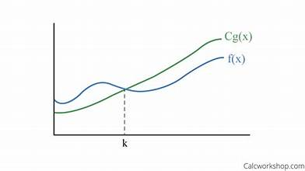
Big Oh (O(n)) – “upper bound”

Slide 53
Big Ω – Big Omega “Lower bound”
For a given function g(n), we denote by Ω(g(n)) the set of functions. Ω (g(n)) = { f(n): there exist positive constants c and n0 such that 0 ≤ c x g(n) ≤ f(n) for all n ≥ n0 }.

Slide 54
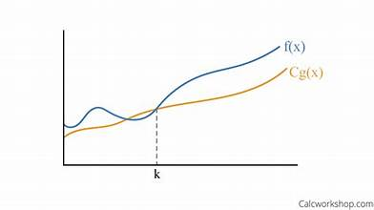
Big Ω – Big Omega – Lower bound

Slide 55
Big Θ – Big Theta “Tight bound”
For a given function g(n), we denote Θ(g(n)) as the following set of functions. Θ(g(n)) = {f(n): there exist positive constants c1, c2 and n0 such that 0 ≤ c1×g(n) ≤ f(n) ≤ c2×g(n) for all n ≥ n0}
This means that g(n) and f(n) have the same running time; are off by just a constant
"Sandwiched" for sufficiently large n
We say g(n) is an asymptotically tight bound for f(n)

Slide 56
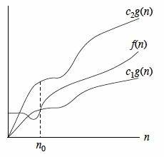
Big Θ – Big Theta – tight bound

Slide 57
Example 1
f(n) = 2n^2 + 3n + 4,
2n^2 + 3n + 4 ≤ 2n^2 + 3n^2 + 4n^2
2n^2 + 3n + 4 ≤ 9n^2
f(n) = O (n^2) also,
2n^2 + 3n + 4 ≥ 1 * n^2
f(n) = Ω (n^2)
=> 1 * n2 ≤ 2n^2 + 3n + 4 ≤ 9n^2 ∀ n ≥ 1 Here, c1=1, c2 = 9, n0=1, g(n)= n^2
=> f(n) = Θ(n^2)

Slide 58
Example 2
Prove that f(n) = 4n^2 + 6n + 3 is Θ(n^2)
You need to prove the two bounds: Ω(g(n)) and O (g(n))
Soln:
4n^2+6n+3 <= 4n^2 + 6n^2 + 3n^2 =13n^2 → f(n) = O(n^2)
4n^2 + 6n + 3 >= n^2 → f(n) = Ω(n^2)
n^2 <= f(n) <= 13n^2 → is Θ(n^2) c1=1, c2=13, n0=1

Slide 59
Example 3
f(n) = n^2 log n + n we can show that:
n^2 log n ≤ n^2 log n + n ≤ 10 n^2 log n
Ω (n^2 log n) Θ(n^2 log n) O(n^2 log n)

Slide 60
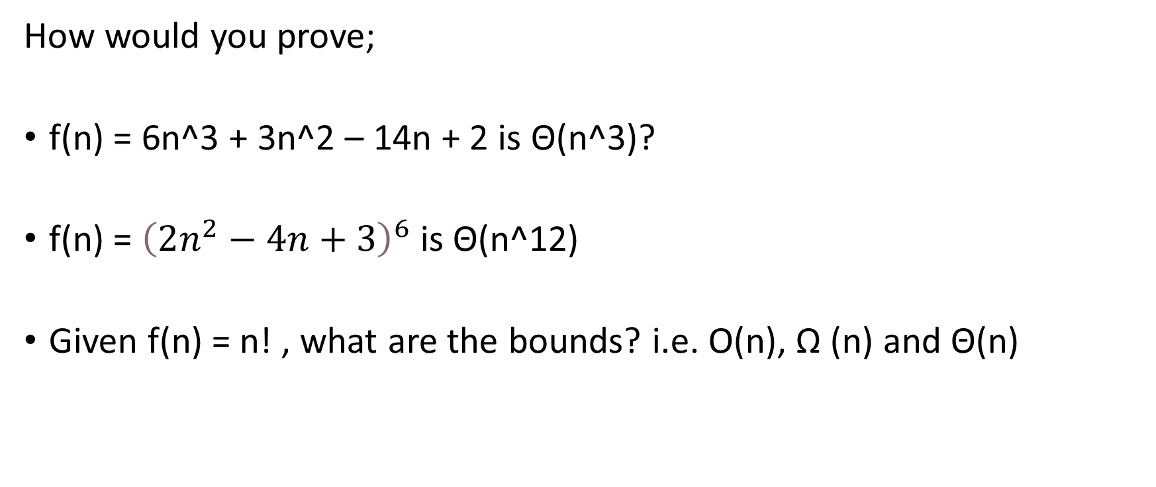
Exercise
How would you prove;
f(n) = 6n^3 + 3n^2 – 14n + 2 is Θ(n^3)?
f(n) = ${\left(2n^{2}−4n+3\right)}^{6}$ is Θ(n^12)
Given f(n) = n! , what are the bounds? i.e. O(n), Ω (n) and Θ(n)

Slide 61
Recurrence Defn
A recurrence relation for the sequence a0, a1, a2 …..an is an equation that relates an to certain of its predecessors
For example an = an-1 + c
Note: For a given sequence a0, a1…….,an initial conditions are explicitly given values for a finite number of the number of the sequence…this are referred as the base cases.

Slide 62
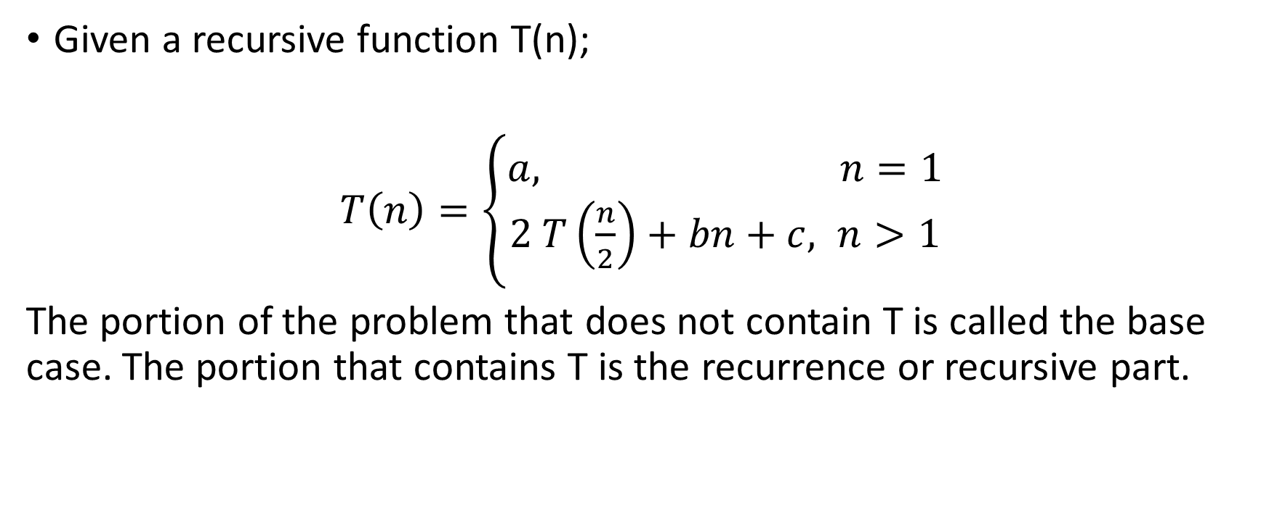
Recurrence Defn cont’d
Given a recursive function T(n);
$T\left(n\right)=\left\{\begin{aligned}a, n=1 \\ &2 T\left(\frac{n}{2}\right)+bn+c, n>1\end{aligned}\right.$
The portion of the problem that does not contain T is called the base case. The portion that contains T is the recurrence or recursive part.

Slide 63
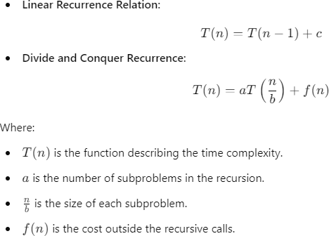
Recurrence cont’d
A recurrence relation is a mathematical formula that recursively defines a sequence. In the context of algorithm analysis, it often expresses the time complexity of recursive algorithms. For example:

Slide 64
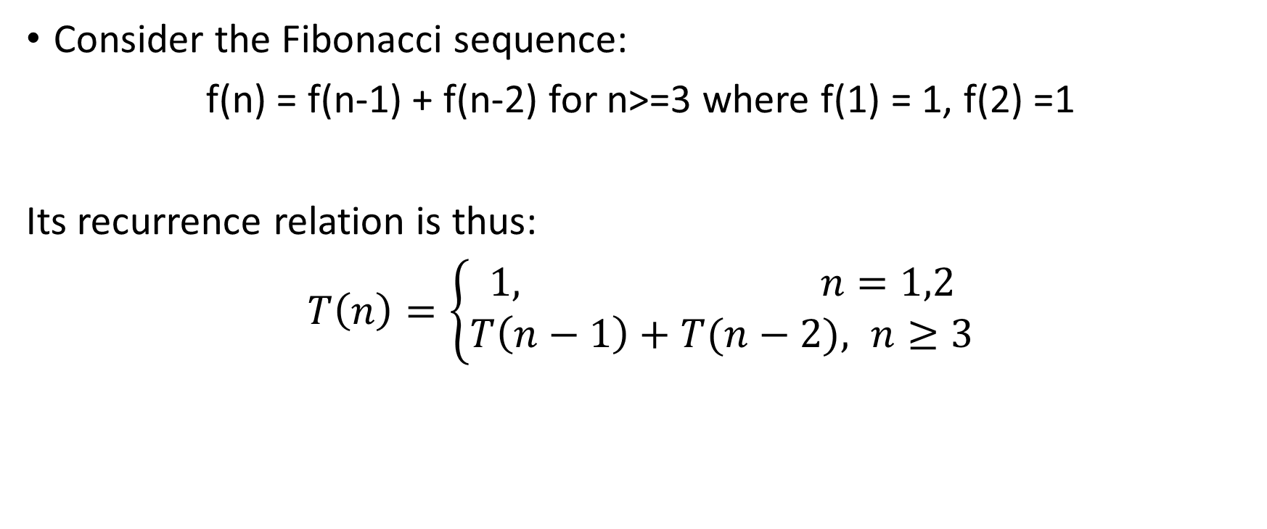
Forming recurrence relations
Consider the Fibonacci sequence:
f(n) = f(n-1) + f(n-2) for n>=3 where f(1) = 1, f(2) =1
Its recurrence relation is thus:
$T\left(n\right)=\left\{\begin{aligned}1, n=1,2 \\ &T\left(n−1\right)+T(n−2), n≥3\end{aligned}\right.$

Slide 65
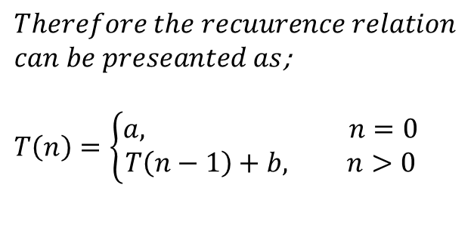
Forming recurrence relations cont’d
What if you are given the following method;
void f(int n){
if (n > 0) {
cout <<n;
f(n-1);
}
}
The base is reached when n =0, where the method does a single comparison. Otherwise, when n > 0 the method performs 2 basic operations and calls itself using 1 recursive call with parameter n-1
$$Therefore the recuurence relation$$
$can be preseanted as$;
$T\left(n\right)=\left\{\begin{aligned}a, n=0 \\ &T\left(n−1\right)+b, n>0\end{aligned}\right.$

Slide 66
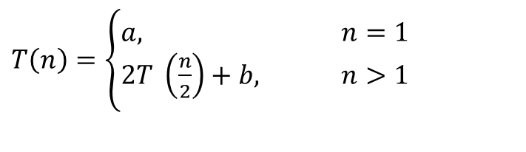
Forming recurrence relations cont’d
Given the following method, what is its recurrence relation?
int g(int n){
if (n==1)
return 2;
else
return g(n/2) + g(n/2) +5
}
$T\left(n\right)=\left\{\begin{aligned}a, n=1 \\ &2T \left(\frac{n}{2}\right)+b, n>1\end{aligned}\right.$

Slide 67
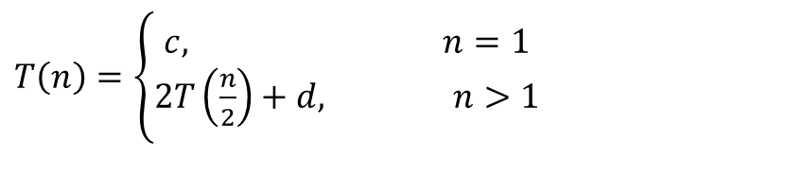
A general recurrence relation
Recurse(A[1…n]){
if n <= 1
return A
if n>1
do_something A
A1 = extract (A)
A2 = extract (A)
B1 = recurse (A1)
B2 = recurse (A2)
B = rebuild (B1, B2)
return B
end
Assuming all other functions do a constant amount of work at each iteration what is the recurrence formula for the given relation?
Further, assume extract returns half of the original array!
$T\left(n\right)=\left\{\begin{aligned}c, n=1 \\ &2T\left(\frac{n}{2}\right)+d, n>1\end{aligned}\right.$

Slide 68
Exercises
Develop the recurrence relations for the sorting algorithms that use recursive functions….discussed in previous lecture

Slide 69
Solving recurrences
Several methods can be used to solve recurrence relations;
Substitution method
Iteration method
Recursion tree method
Master theorem method

Slide 70
Recursion tree method
Recursive analysis considers the shape of the recursion tree created by the recursive call structures! And then approximates the total cost
See examples on pdf file

Slide 71
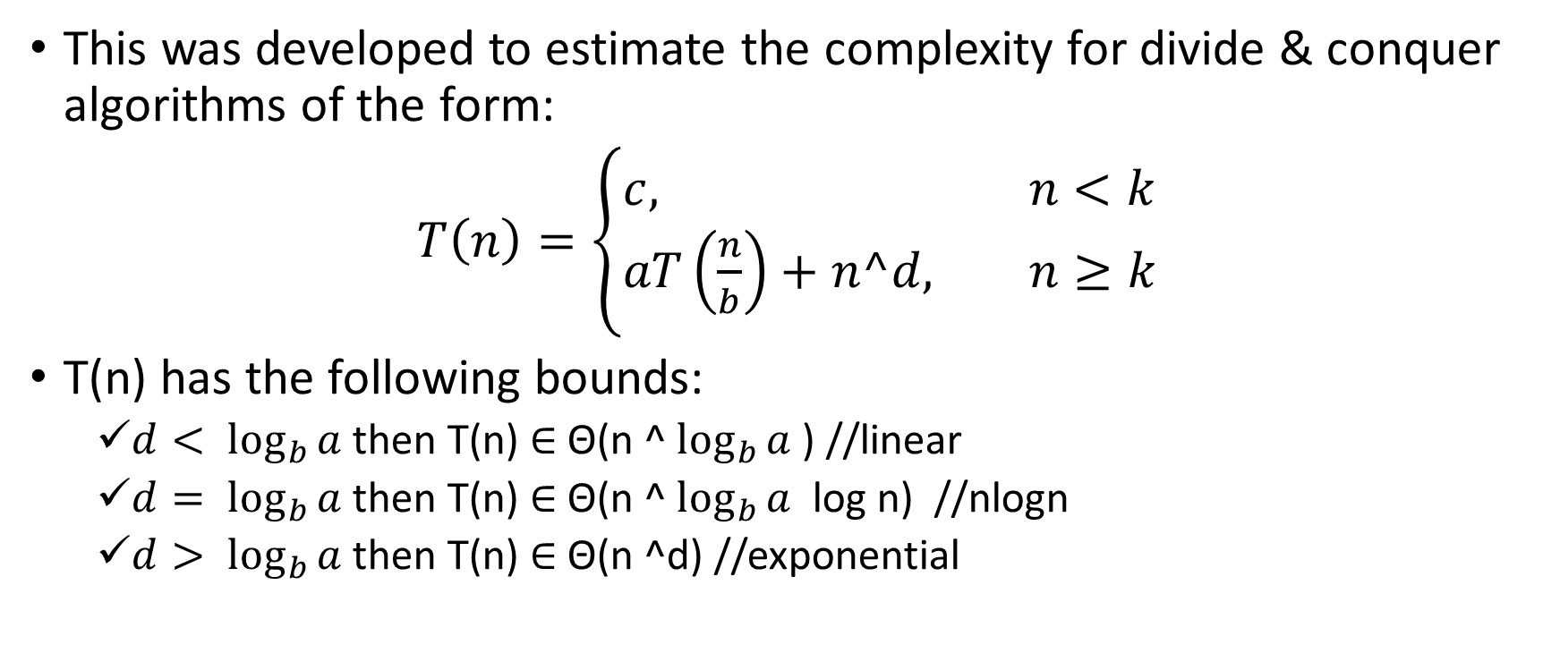
Master Theorem
This was developed to estimate the complexity for divide & conquer algorithms of the form:
$T\left(n\right)=\left\{\begin{aligned}c, n<k \\ &aT\left(\frac{n}{b}\right)+n^d, n≥k\end{aligned}\right.$
T(n) has the following bounds:
$d< \log_{b}{a}$ then T(n) ∈ Θ(n ^ $\log_{b}{a}$ ) //linear
$d= \log_{b}{a}$ then T(n) ∈ Θ(n ^ $\log_{b}{a}$ log n) //nlogn
$d> \log_{b}{a}$ then T(n) ∈ Θ(n ^d) //exponential

Slide 72
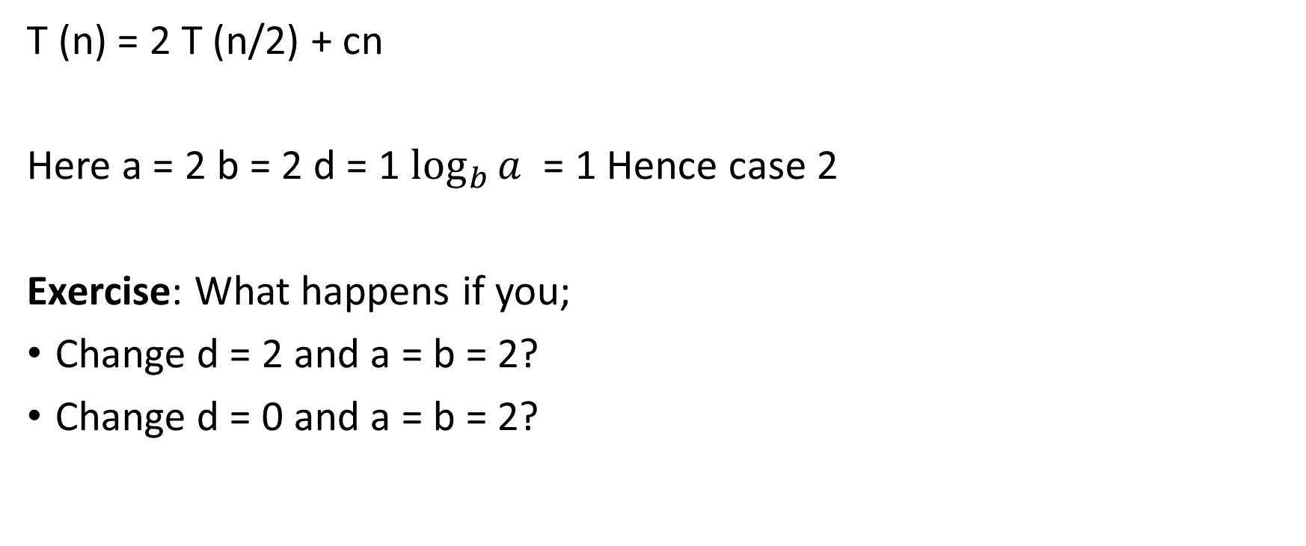
Example
T (n) = 2 T (n/2) + cn
Here a = 2 b = 2 d = 1 $\log_{b}{a}$ = 1 Hence case 2
Exercise: What happens if you;
Change d = 2 and a = b = 2?
Change d = 0 and a = b = 2?

